Slide 1
Agentic AI-Powered Financial Crime Detection: From Theory to Production
François Protopapa, Principal SA GenAI & Search specialist.

Slide 2
An AI agent is a system that can perceive its environment, reason about what it observes, plan a sequence of actions, and execute those actions to achieve specific goals
Notes:
Perceive - agent collects data - which can include visual data, text, speech, or other inputs
Reason: agent processes the info to build a model of the environment its working in or the data its working with
then uses algorithms for reasoning to decide on the best course of action.
Plan: based on the reason and goals, the agent plans a sequence of actions to achieve those objectives
Action: The agent executes the planned actions using the tools it has available to achieve the desired results

Slide 3
Putting the Definition to Work
Perceive
Reason
Plan
Execute
Ingesting terabytes of Transaction Logs, Client Profiles, and Global News feeds in real-time.
Identifying complex patterns like "Structuring" or "Sanctions Evasion" that rule-based systems miss.
Deciding which Tool to use next (e.g., "I see a risk, I need to check the Compliance Handbook").
Generating a grounded Risk Assessment citing specific Bank’s Policy IDs (e.g., AML-100).
An Agent that does not just 'chat', it investigates, validates, and adjudicates financial crime alerts.
Notes:
In the previous session, we defined what an AI Agent is. Now, we stop talking about definitions.
We are going to see this definition live in a bank context. We’ve built an Agent that doesn't just 'chat'—it investigates, validates, and adjudicates financial crime alerts.

Slide 4
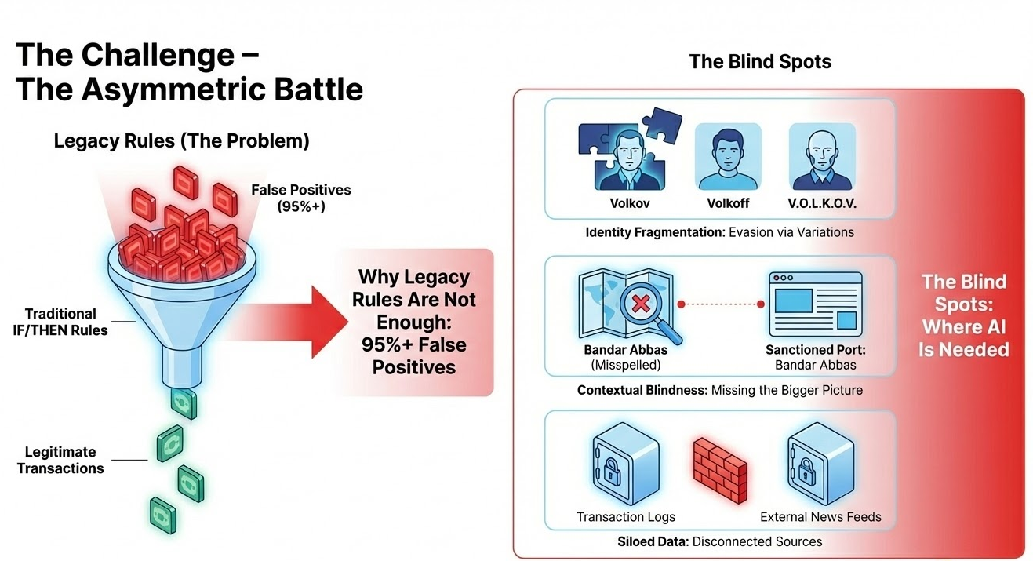
Notes:
Criminals don't follow static rules. They fragment identities and hide in the noise.
Our current systems struggle to connect the dots between a transaction, a policy document, and a news article.
Why Legacy Rules Are Not Enough
We need an Agent that sees the whole picture.

Slide 5





The Distribution Challenge - Why Not One Big Database?
We bring the questions to the data, not the data to the questions.
The Pain Points
Exploding & Diverse Data: Chats, documents, transactions, and OSINT create massive, unstructured volumes that are hard to query.
Search Blind Spots: Traditional keyword search misses context, synonyms, and relationships, leaving critical evidence buried.
The Silo Barrier: Data is legally and operationally locked within distributed Cantonal and Federal systems.
The Solution: Intelligent Federation
Unified Access: Cross-Cluster Search queries data where it lives—solving the distribution challenge without migration.
Semantic Understanding: AI Agents move beyond keywords to understand intent, finding hidden connections across diverse formats.
Total Visibility: A single layer connecting local forensics with federal intelligence.
CRM
Transactions
Legal & Policies
Media
Notes:
"We bring the questions to the data, not the data to the questions—ensuring speed, compliance, and complete investigative visibility."

Slide 6




Building the "Bank Financial Crime AI Agents"
Sources
Global Client View
Transaction Patterns
Policy & Legal Framework
Adverse Media / OSINT

Slide 7
Building the "Bank Financial Crime AI Agents"
Sources
Global Client View
Transaction Patterns
Policy & Legal Framework
Adverse Media / OSINT
Entity Resolution across regions (EMEA, AMER, APJ).
Detecting behavioral anomalies (Smurfing, Crypto flows)
"Grounding" every decision in specific bank’s rules
Real-time news scanning for confirmation or exoneration
Tools
search_global_client_database
analyze_transaction_patterns
consult_compliance_handbook
scan_adverse_media

Slide 8
Building the "Bank Financial Crime AI Agents"
Sources
Global Client View
Transaction Patterns
Policy & Legal Framework
Adverse Media / OSINT
Entity Resolution across regions (EMEA, AMER, APJ).
Detecting behavioral anomalies (Smurfing, Crypto flows)
"Grounding" every decision in specific bank’s rules
Real-time news scanning for confirmation or exoneration
Tools
search_global_client_database
analyze_transaction_patterns
consult_compliance_handbook
scan_adverse_media
Agents
Global Customer View
Bank Financial Crime AI Investigator

Slide 9






Building the "Bank Financial Crime AI Agents"
Sources
Global Client View
Transaction Patterns
Policy & Legal Framework
Adverse Media / OSINT
Entity Resolution across regions (EMEA, AMER, APJ).
Detecting behavioral anomalies (Smurfing, Crypto flows)
"Grounding" every decision in specific bank’s rules
Real-time news scanning for confirmation or exoneration
Tools
search_global_client_database
analyze_transaction_patterns
consult_compliance_handbook
scan_adverse_media
Agents
Global Customer View
Bank Financial Crime AI Investigator
Elastic MCP Server
Search AI & GUI
Notes:
This is the engine room. We haven't just fed documents to a chatbot. We have given the Agent distinct Tools.
It knows when to look at the Policy Handbook and when to search Google News. This orchestration is what turns a generic model into a specialized Investigator.

Slide 10

DEMO

Slide 11


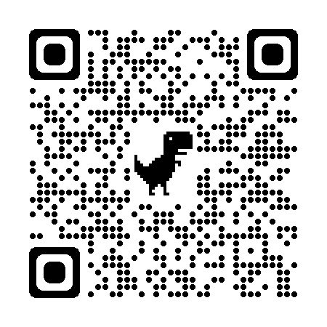
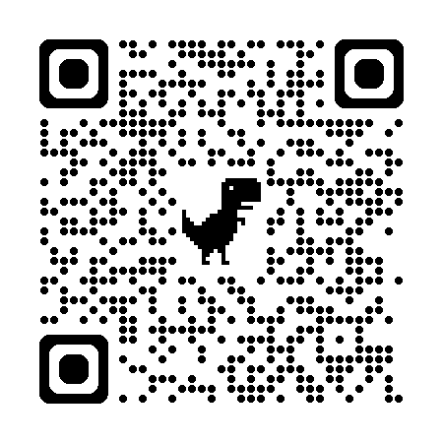





Github Source
Search Labs Blog
Search Labs
elastic-fincrime-agent
elastic.co/search-labs
github.com/elastic/elasticsearch-labs
Thank you !

